Slide 1
Search Bugs Fast
with Elasticsearch
https://github.com/klahnakoski/MoDevMetrics

Slide 2
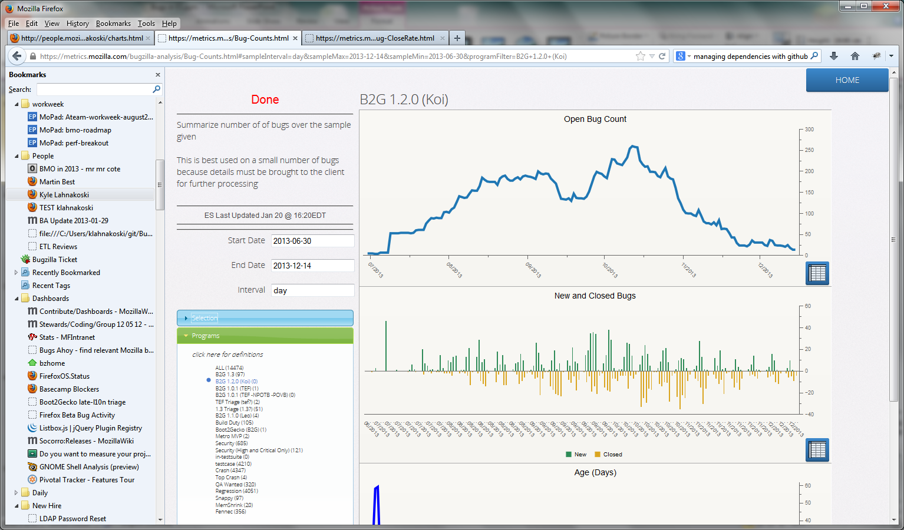
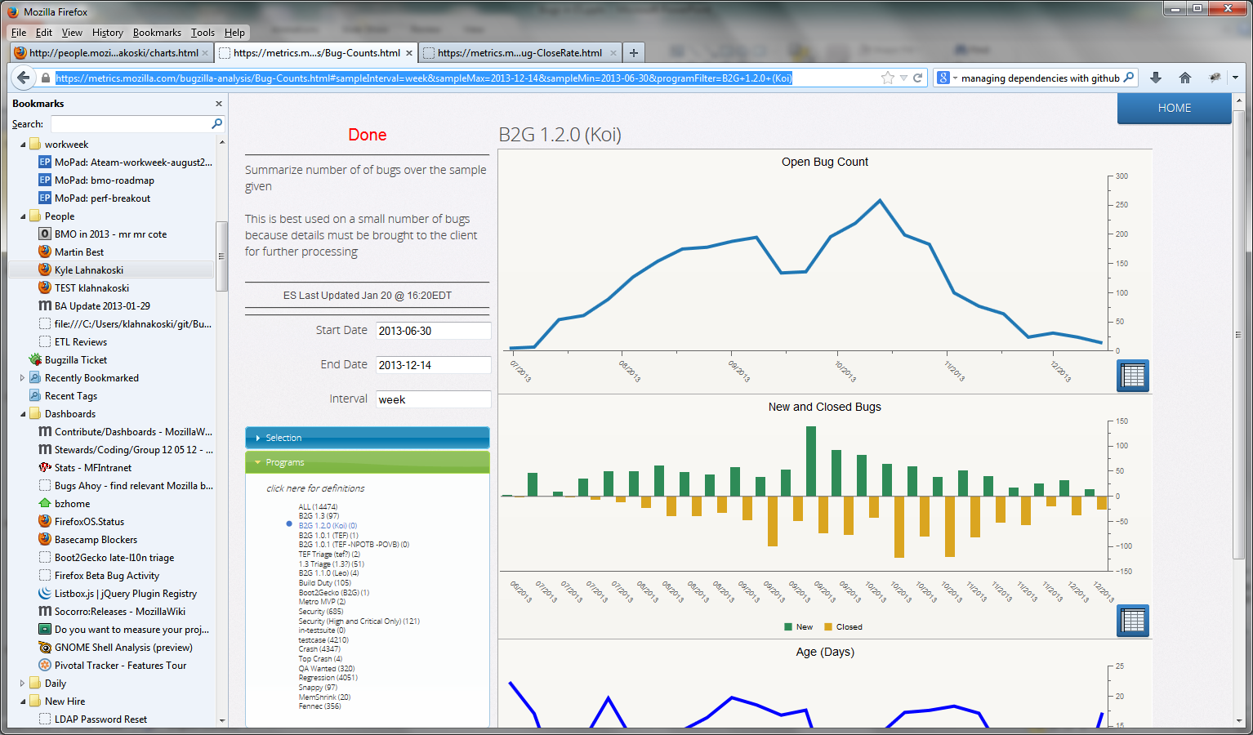
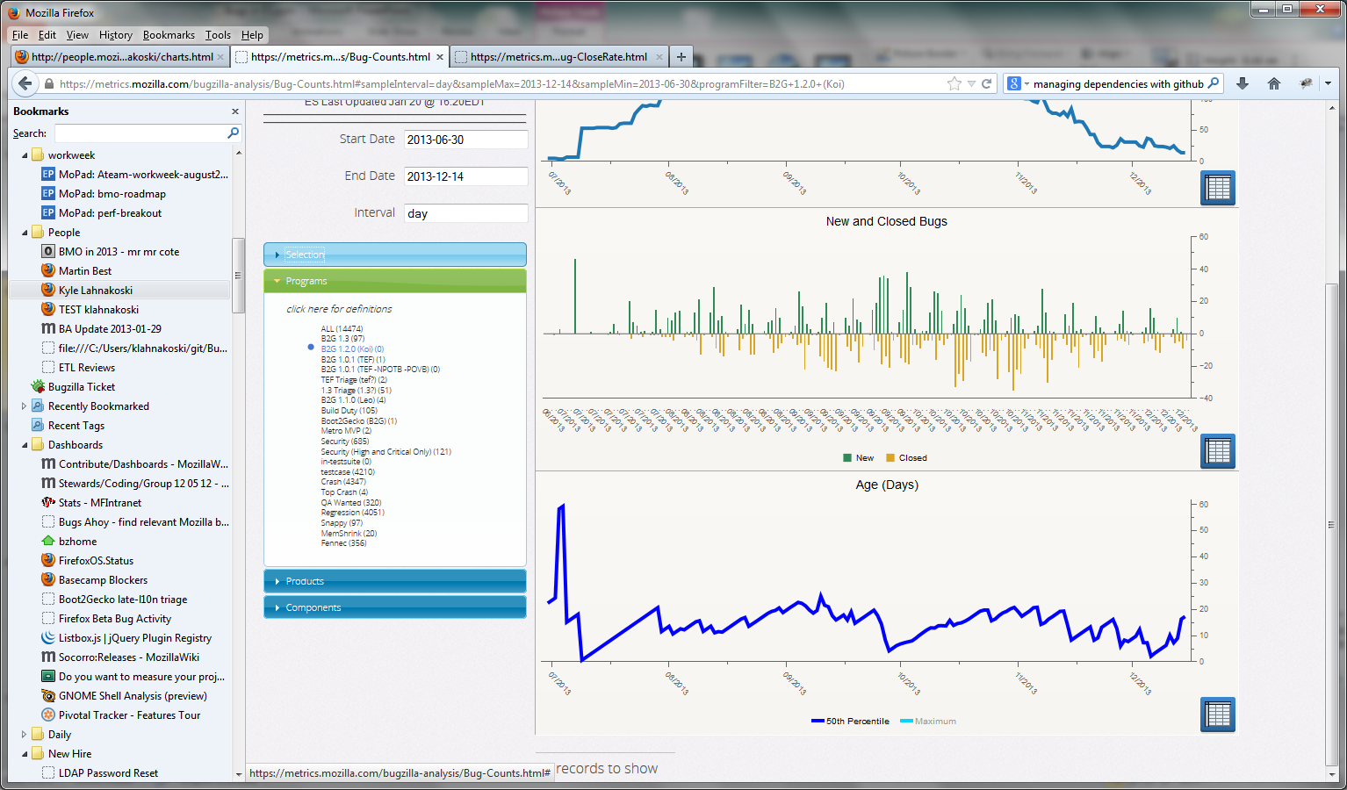
Past Work with Elasticsearch
Open Bug Counts
Open/Close Rates
Age of Open Bugs
https://metrics.mozilla.com/bugzilla-analysis/Bug-Counts.html#sampleInterval=week&sampleMax=2013-12-14&sampleMin=2013-06-30&programFilter=B2G+1.2.0+%28Koi%29
Notes:
https://metrics.mozilla.com/bugzilla-analysis/Bug-Counts.html#sampleInterval=week&sampleMax=2013-12-14&sampleMin=2013-06-30&programFilter=B2G+1.2.0+%28Koi%29

Slide 3
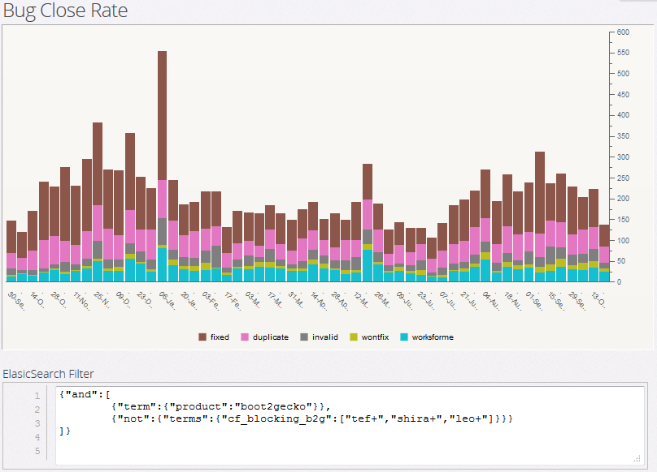
Past Work with Elasticsearch
Close Rates by Resolution
https://metrics.mozilla.com/bugzilla-analysis/Bug-CloseRate.html#filter=%257B%22and%22%3A%255B%0A%09%257B%22term%22%3A%257B%22product%22%3A%22boot2gecko%22%257D%257D,%0A%09%257B%22not%22%3A%257B%22terms%22%3A%257B%22cf_blocking_b2g%22%3A%255B%22tef%2B%22,%22shira%2B%22,%22leo%2B%22%255D%257D%257D%257D%0A%255D%257D&sampleInterval=week&sampleMax=2013-10-26&sampleMin=2012-09-30

Slide 4
Past Work with Elasticsearch
Close Rates by Resolution
Boot2Gecko product, outside the B2G projects
https://metrics.mozilla.com/bugzilla-analysis/Bug-CloseRate.html#filter=%257B%22and%22%3A%255B%0A%09%257B%22term%22%3A%257B%22product%22%3A%22boot2gecko%22%257D%257D,%0A%09%257B%22not%22%3A%257B%22terms%22%3A%257B%22cf_blocking_b2g%22%3A%255B%22tef%2B%22,%22shira%2B%22,%22leo%2B%22%255D%257D%257D%257D%0A%255D%257D&sampleInterval=week&sampleMax=2013-10-26&sampleMin=2012-09-30
Notes:
https://metrics.mozilla.com/bugzilla-analysis/Bug-CloseRate.html#filter=%257B%22and%22%3A%255B%0A%09%257B%22term%22%3A%257B%22product%22%3A%22boot2gecko%22%257D%257D,%0A%09%257B%22not%22%3A%257B%22terms%22%3A%257B%22cf_blocking_b2g%22%3A%255B%22tef%2B%22,%22shira%2B%22,%22leo%2B%22%255D%257D%257D%257D%0A%255D%257D&sampleInterval=week&sampleMax=2013-10-26&sampleMin=2012-09-30

Slide 5
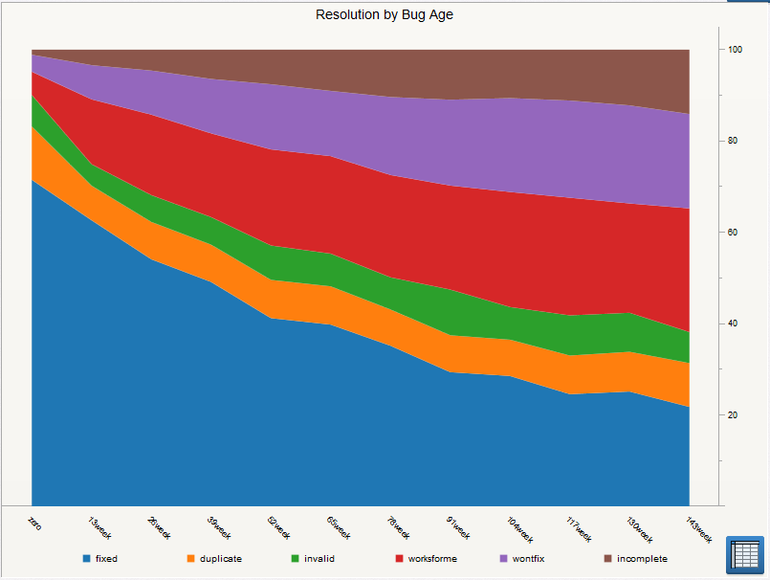
Past Work with Elasticsearch
We expected older bugs to have less chance of being FIXED

Slide 6
Past Work with Elasticsearch
Invalid rate almost constant!

Slide 7
Past Work with Elasticsearch
Dup rate almost constant too!

Slide 8
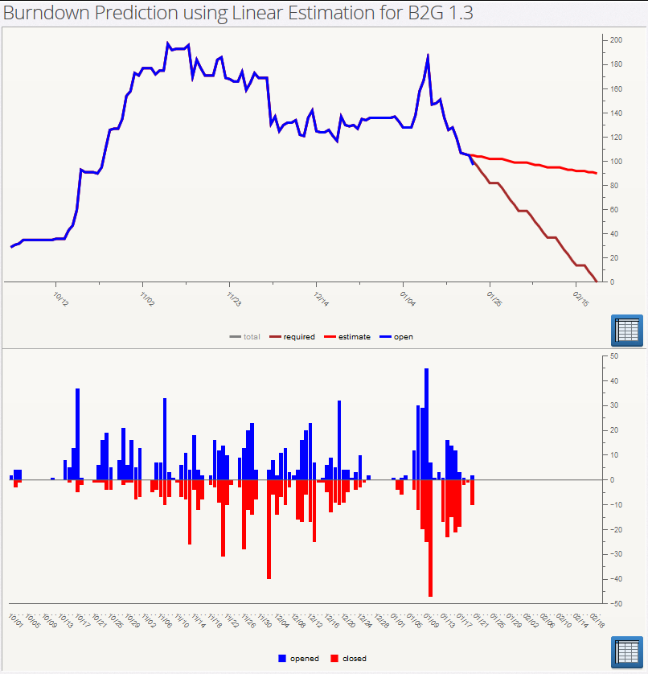
Past Work with Elasticsearch
Open Bug Count
Open and Close rates
https://metrics.mozilla.com/bugzilla-analysis/Predictive_Simple.html#programFilter=B2G+1.3&dueDate=2014-02-20&sampleMin=2013-10-01&titleName=
Notes:
https://metrics.mozilla.com/bugzilla-analysis/Predictive_Simple.html#programFilter=B2G+1.3&dueDate=2014-02-20&sampleMin=2013-10-01&titleName=

Slide 9
Past Work with Elasticsearch
Linear projection of burn-down based on past
6 weeks’ data
https://metrics.mozilla.com/bugzilla-analysis/Predictive_Simple.html#programFilter=B2G+1.3&dueDate=2014-02-20&sampleMin=2013-10-01&titleName=
Notes:
https://metrics.mozilla.com/bugzilla-analysis/Predictive_Simple.html#programFilter=B2G+1.3&dueDate=2014-02-20&sampleMin=2013-10-01&titleName=

Slide 10
Past Work with Elasticsearch
Linear projection of burn-down based on past
6 weeks’ data
Required to meet deadline
https://metrics.mozilla.com/bugzilla-analysis/Predictive_Simple.html#programFilter=B2G+1.3&dueDate=2014-02-20&sampleMin=2013-10-01&titleName=
Notes:
https://metrics.mozilla.com/bugzilla-analysis/Predictive_Simple.html#programFilter=B2G+1.3&dueDate=2014-02-20&sampleMin=2013-10-01&titleName=

Slide 11
Past Work with Elasticsearch
Linear projection of burn-down based on past
6 weeks’ data
Required to meet deadline
Holiday
https://metrics.mozilla.com/bugzilla-analysis/Predictive_Simple.html#programFilter=B2G+1.3&dueDate=2014-02-20&sampleMin=2013-10-01&titleName=
Notes:
https://metrics.mozilla.com/bugzilla-analysis/Predictive_Simple.html#programFilter=B2G+1.3&dueDate=2014-02-20&sampleMin=2013-10-01&titleName=

Slide 12
Past Work with Elasticsearch
Linear projection of burn-down based on past
6 weeks’ data
Required to meet deadline
Summit
Holiday
https://metrics.mozilla.com/bugzilla-analysis/Predictive_Simple.html#programFilter=B2G+1.3&dueDate=2014-02-20&sampleMin=2013-10-01&titleName=
Notes:
https://metrics.mozilla.com/bugzilla-analysis/Predictive_Simple.html#programFilter=B2G+1.3&dueDate=2014-02-20&sampleMin=2013-10-01&titleName=

Slide 13
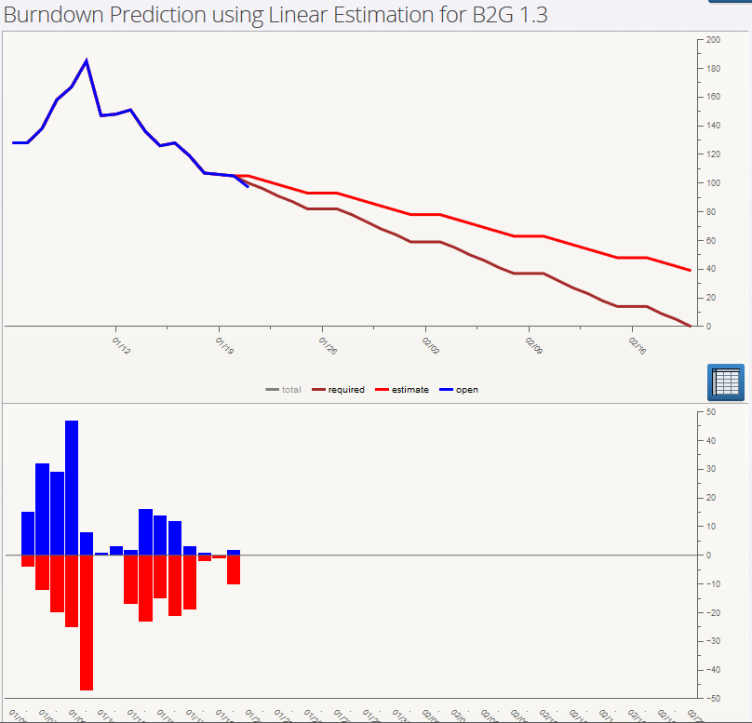
Past Work with Elasticsearch
Better to use past
2 weeks?
Current projection
https://metrics.mozilla.com/bugzilla-analysis/Predictive_Simple.html#programFilter=B2G+1.3&dueDate=2014-02-20&sampleMin=2014-01-05&titleName=

Slide 14
Past Work with Elasticsearch
Better to use past
2 weeks?
Current projection
Required to meet deadline
https://metrics.mozilla.com/bugzilla-analysis/Predictive_Simple.html#programFilter=B2G+1.3&dueDate=2014-02-20&sampleMin=2014-01-05&titleName=
Notes:
https://metrics.mozilla.com/bugzilla-analysis/Predictive_Simple.html#programFilter=B2G+1.3&dueDate=2014-02-20&sampleMin=2014-01-05&titleName=
Actual numbers are available

Slide 15
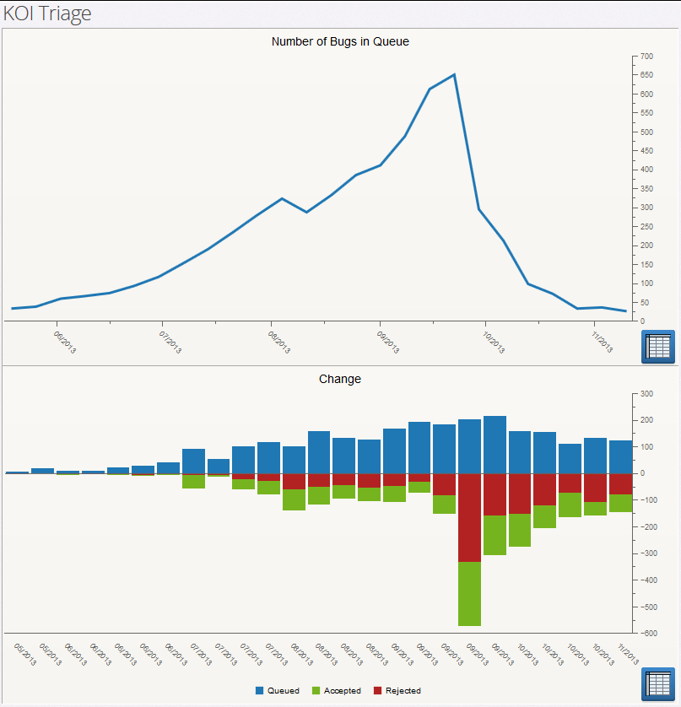
Past Work with Elasticsearch
Bugs in KOI? Triage
https://metrics.mozilla.com/bugzilla-analysis/KOI-TriageRate.html#sampleInterval=week&sampleMax=2013-11-09&sampleMin=2013-04-28
Notes:
https://metrics.mozilla.com/bugzilla-analysis/KOI-TriageRate.html#sampleInterval=week&sampleMax=2013-11-09&sampleMin=2013-04-28

Slide 16
Past Work with Elasticsearch
Bugs in KOI? Triage
Added to Queue (?)
https://metrics.mozilla.com/bugzilla-analysis/KOI-TriageRate.html#sampleInterval=week&sampleMax=2013-11-09&sampleMin=2013-04-28

Slide 17
Past Work with Elasticsearch
Bugs in KOI? Triage
Added to Queue (?)
Rejected (-)
https://metrics.mozilla.com/bugzilla-analysis/KOI-TriageRate.html#sampleInterval=week&sampleMax=2013-11-09&sampleMin=2013-04-28

Slide 18
Past Work with Elasticsearch
Bugs in KOI? Triage
Added to Queue (?)
Rejected (-)
Accepted (+)
https://metrics.mozilla.com/bugzilla-analysis/KOI-TriageRate.html#sampleInterval=week&sampleMax=2013-11-09&sampleMin=2013-04-28

Slide 19
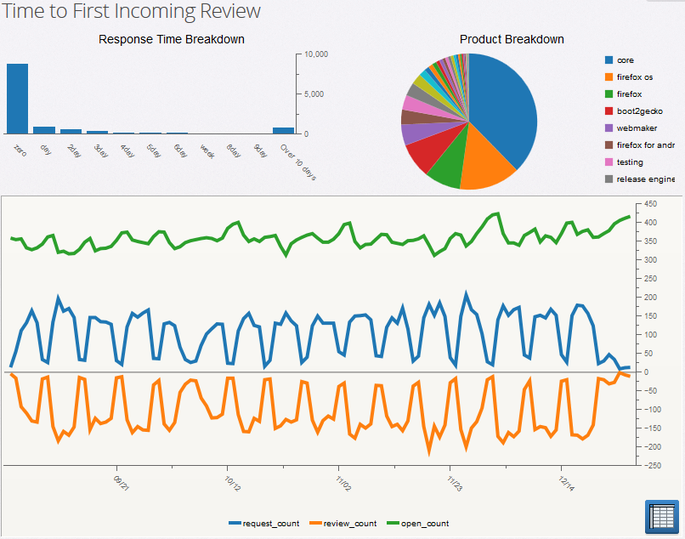
Past Work with Elasticsearch
70% reviews done in a day
https://metrics.mozilla.com/bugzilla-analysis/ReviewIntensity_First.html#sampleInterval=day&sampleMax=2013-12-27&sampleMin=2013-09-01&requestee=
Notes:
https://metrics.mozilla.com/bugzilla-analysis/ReviewIntensity_First.html#sampleInterval=day&sampleMax=2013-12-27&sampleMin=2013-09-01&requestee=

Slide 20
Past Work with Elasticsearch
Long tail
https://metrics.mozilla.com/bugzilla-analysis/ReviewIntensity_First.html#sampleInterval=day&sampleMax=2013-12-27&sampleMin=2013-09-01&requestee=

Slide 21
Past Work with Elasticsearch
Total reviews waiting over a day
https://metrics.mozilla.com/bugzilla-analysis/ReviewIntensity_First.html#sampleInterval=day&sampleMax=2013-12-27&sampleMin=2013-09-01&requestee=

Slide 22
Past Work with Elasticsearch
Total reviews waiting over a day
Reviews requested
https://metrics.mozilla.com/bugzilla-analysis/ReviewIntensity_First.html#sampleInterval=day&sampleMax=2013-12-27&sampleMin=2013-09-01&requestee=

Slide 23
Past Work with Elasticsearch
Total reviews waiting over a day
Reviews requested
Reviews completed
https://metrics.mozilla.com/bugzilla-analysis/ReviewIntensity_First.html#sampleInterval=day&sampleMax=2013-12-27&sampleMin=2013-09-01&requestee=

Slide 24
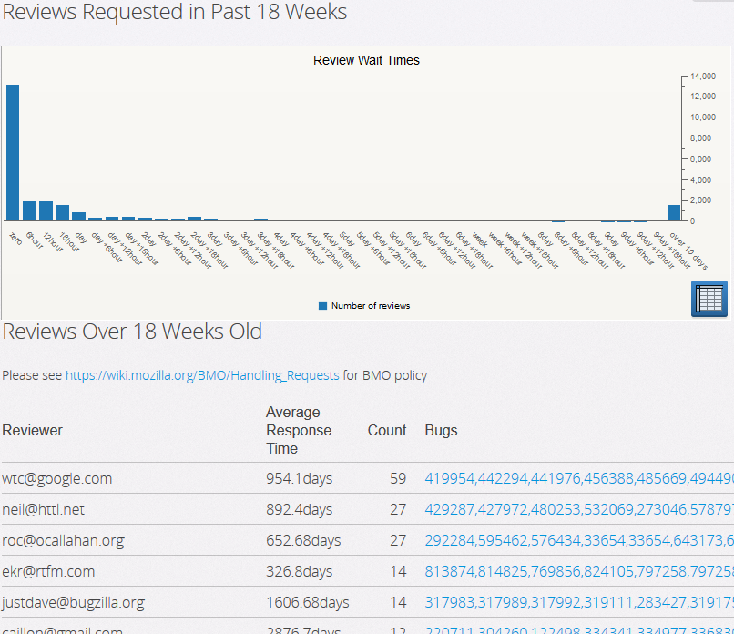
Past Work with Elasticsearch
Most reviews done inside 6 hours!
https://metrics.mozilla.com/bugzilla-analysis/Reviews_Pending_18.html#
Notes:
https://metrics.mozilla.com/bugzilla-analysis/Reviews_Pending_18.html#

Slide 25
Past Work with Elasticsearch
Most reviews done inside 6 hours!
Very long tail
https://metrics.mozilla.com/bugzilla-analysis/Reviews_Pending_18.html#

Slide 26
Past Work with Elasticsearch
Most reviews done inside 6 hours!
Very long tail
Dear Me!
https://metrics.mozilla.com/bugzilla-analysis/Reviews_Pending_18.html#
Notes:
Other issues:
two reviews requested – who is it assigned to.

Slide 27
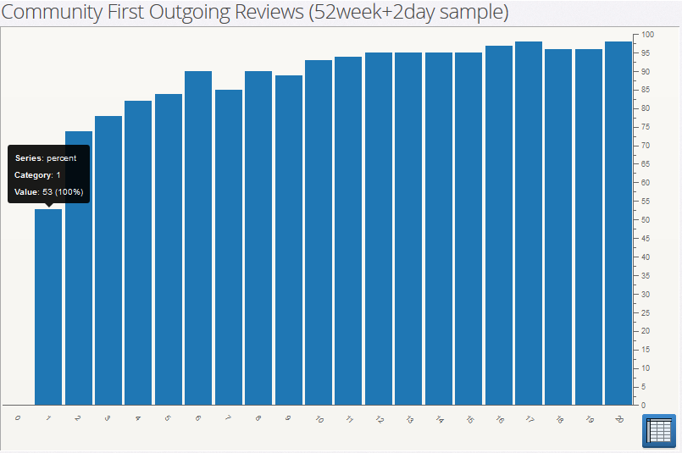
Past Work with Elasticsearch
More patches means more likely to continue
After first patch, 53% will submit a second patch (inside 3 months)
https://metrics.mozilla.com/bugzilla-analysis/Community_NextReviews.html#window=13week&sampleMax=2014-01-01&sampleMin=2013-01-01
Notes:
https://metrics.mozilla.com/bugzilla-analysis/Community_NextReviews.html#window=13week&sampleMax=2014-01-01&sampleMin=2013-01-01

Slide 28
Past Work with Elasticsearch
More patches means more likely to continue
After the second patch, 74% will submit a third
(inside 3 months)
https://metrics.mozilla.com/bugzilla-analysis/Community_NextReviews.html#window=13week&sampleMax=2014-01-01&sampleMin=2013-01-01

Slide 29
Past Work with Elasticsearch
More patches means more likely to continue
and so on…
https://metrics.mozilla.com/bugzilla-analysis/Community_NextReviews.html#window=13week&sampleMax=2014-01-01&sampleMin=2013-01-01

Slide 30
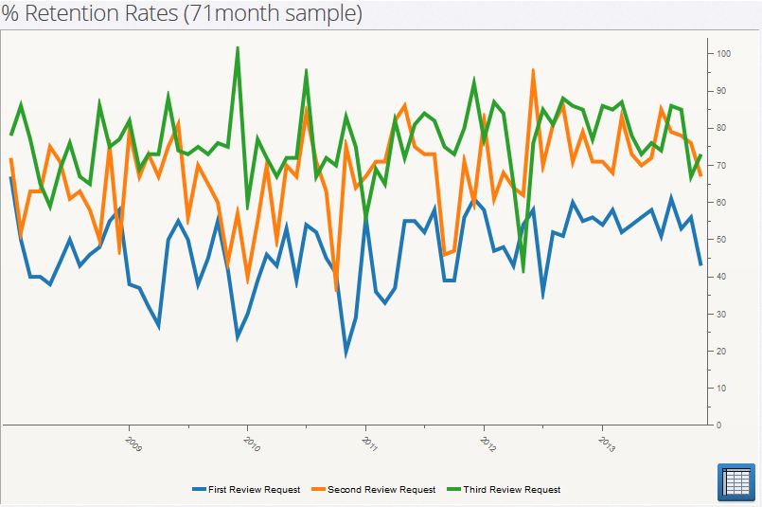
Past Work with Elasticsearch
Looking at “retention” over past 5 years
https://metrics.mozilla.com/bugzilla-analysis/Community_Retention.html#window=13week&sampleInterval=month&sampleMax=2013-11-30&sampleMin=2008-01-01
Notes:
https://metrics.mozilla.com/bugzilla-analysis/Community_Retention.html#window=13week&sampleInterval=month&sampleMax=2013-11-30&sampleMin=2008-01-01

Slide 31
Past Work with Elasticsearch
Looking at “retention” over past 5 years
Very noisy, maybe there is a deeper pattern?
https://metrics.mozilla.com/bugzilla-analysis/Community_Retention.html#window=13week&sampleInterval=month&sampleMax=2013-11-30&sampleMin=2008-01-01

Slide 32
Past Work with Elasticsearch
Looking at “retention” over past 5 years
Less noise, and higher retention after late 2012
https://metrics.mozilla.com/bugzilla-analysis/Community_Retention.html#window=13week&sampleInterval=month&sampleMax=2013-11-30&sampleMin=2008-01-01

Slide 33
Past Work with Elasticsearch
Looking at “retention” over past 5 years
Edge effect: Not enough time to see if person will submit another patch
https://metrics.mozilla.com/bugzilla-analysis/Community_Retention.html#window=13week&sampleInterval=month&sampleMax=2013-11-30&sampleMin=2008-01-01

Slide 34
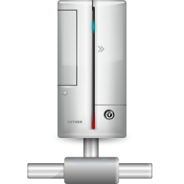


Architecture
web/file server
ajax
Browser
Elasticsearch

Slide 35

Architecture
web/file server
ajax
Browser
ETL
Bugzilla DB
Elasticsearch

Slide 36
Architecture
Talos
web/file server
Mercurial
ajax
Browser
ETL
Telemetry
(10% of one month)
Bugzilla DB
Elasticsearch
Perfy
Phonebook

Slide 37
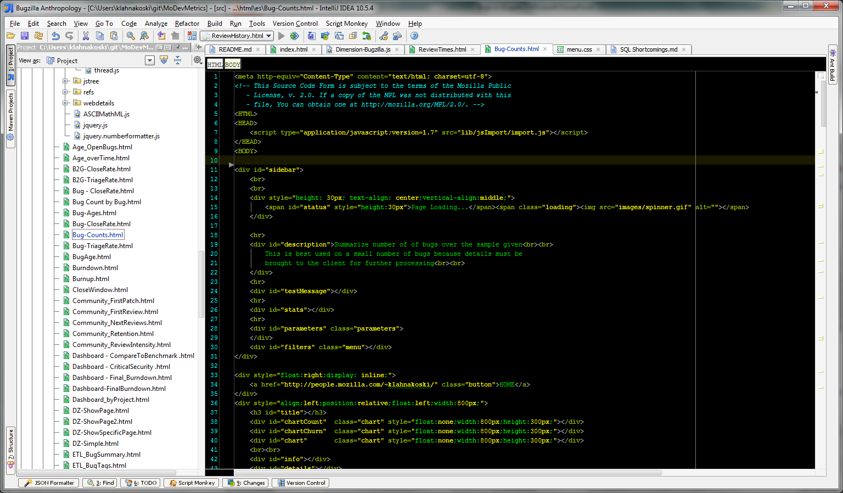
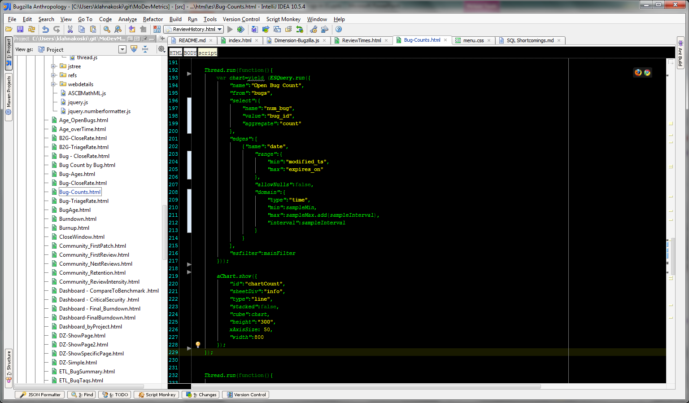
Making a Dashboard
<html>
<head/>
<body>
content
<script>
code
</script>
</body>
</html>

Slide 38
Making a Dashboard
<html>
<head/>
<body>
content
<script>
code
</script>
</body>
</html>
<script type="application/javascript;version=1.7">

Slide 39
Making a Dashboard

Slide 40
Making a Dashboard

Slide 41
Making a Dashboard

Slide 42
Future Plans
Use Elasticsearch for what it was meant: Seaching text comments
ES has a limited form of join
Make a query service?

Slide 43
The End

